Slide 1
Optimizing Monte Carlo Path Tracer using CUDA programming
By: Vansh Dhar (USC ID: 2505769073)
Abhishek Mishra (USC ID: 3432233339)
EE/CSCI 451: Project Presentation
University of Southern California

Slide 2
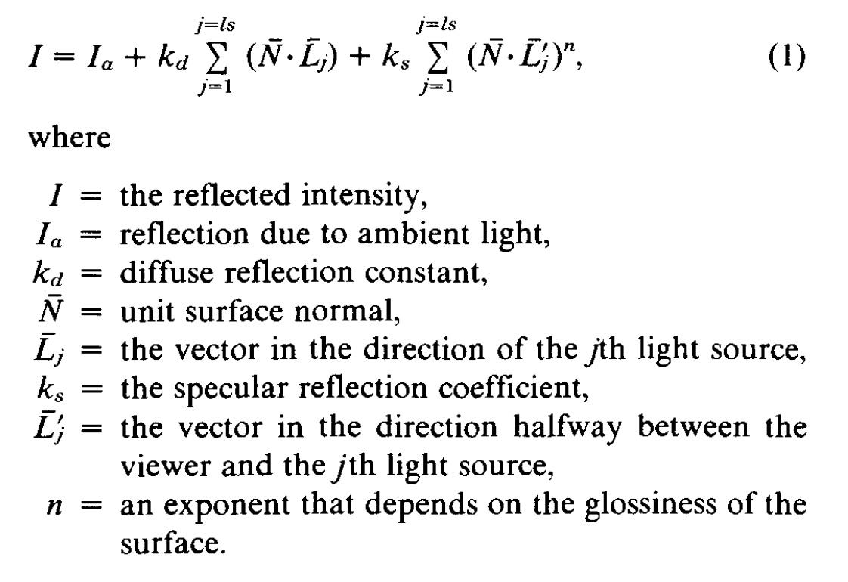
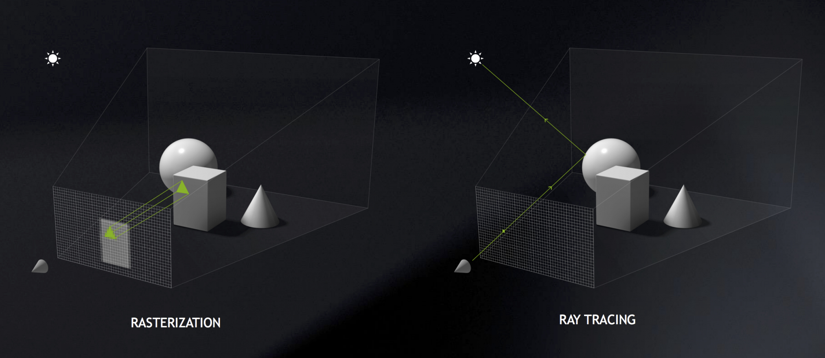
Brief Overview: Rendering
Notes:
Inform about CG, RENDERING TECHNIQUES, USE CASES for mobile applications or high end desktop applications

Slide 3
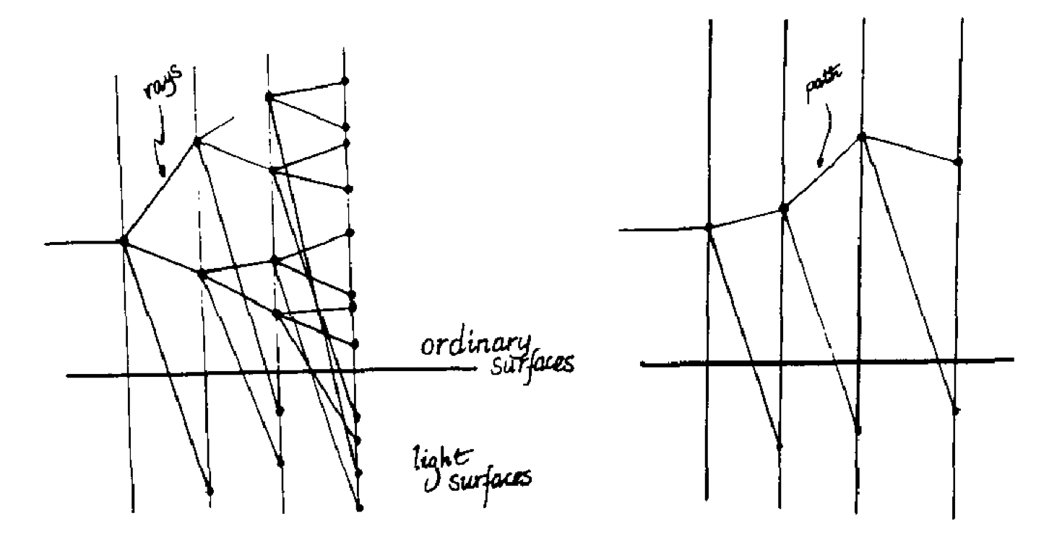
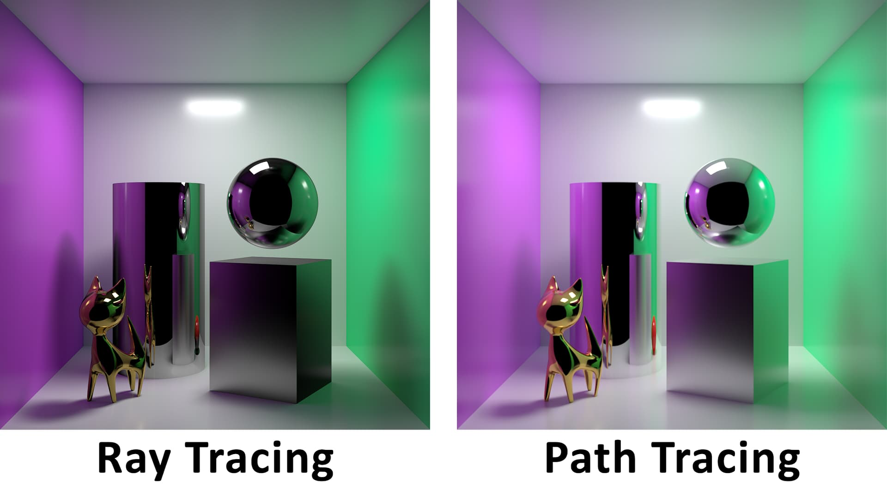
Brief Overview: Rendering
Ray and Path Tracing Visualized
Notes:
Difference between ray tracing and path tracing (Rendering is a real time problem) play games ar vr (Ray tracing ray splits into multiple directions (reflected, refracted and to each light source)) path tracing focuses on only one path using importance sampling. (Ray tracing focus more on useless info) This is very important for variance reduction for motion blur, depth of field, and other effects in distributed ray tracing. (caustics)
Path tracing based on monte carlo integration

Slide 4
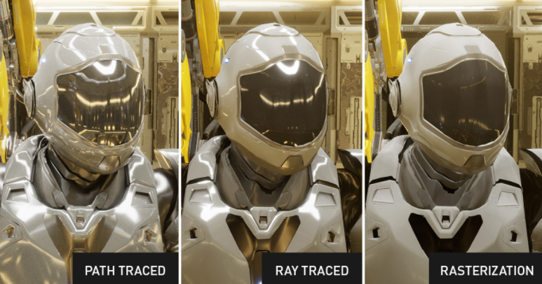
Brief Overview: Rendering
Notes:
Why path tracing? why is it important? why parallelization is necessary

Slide 5
Features in Our Rendering System
Movable Camera
Moving 3D object
Light-emitting object
Texture Mapping
Bounding Volume Hierarchies
Metal, Glass, Diffuse Elements
Important From Graphics Perspective

Slide 6
Features in Our Rendering System
Pixel Color Computation
Anti-aliasing (Sampling Rate)
3D World Design
Image Resolution
Important From Parallelization Perspective
Notes:
Talk about parallelization efforts,

Slide 7
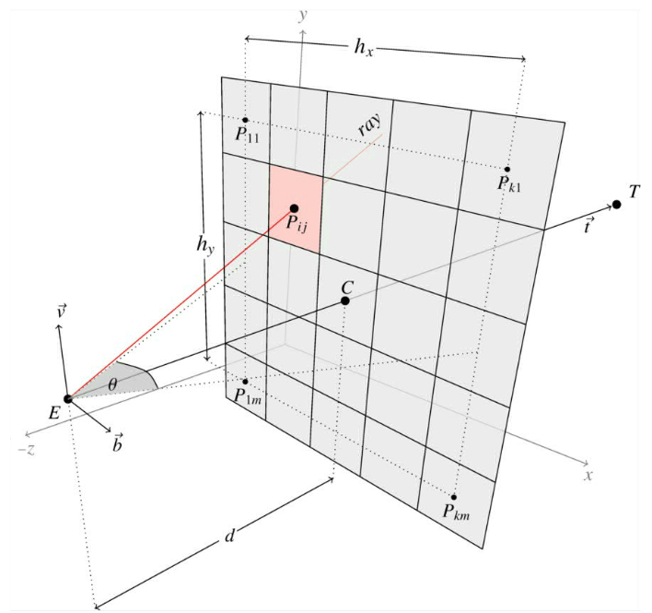
Pixel Color Computation
Each Pixels’ Value can be computed in parallel
Notes:
Pixel color computation and anti-aliasing important from parallelization perspective
3D world design and image resolution is important for optimizing gpu usage and preventing bottle neck, This is very important for variance reduction for motion blur, depth of field, and other effects in distributed ray tracing.

Slide 8
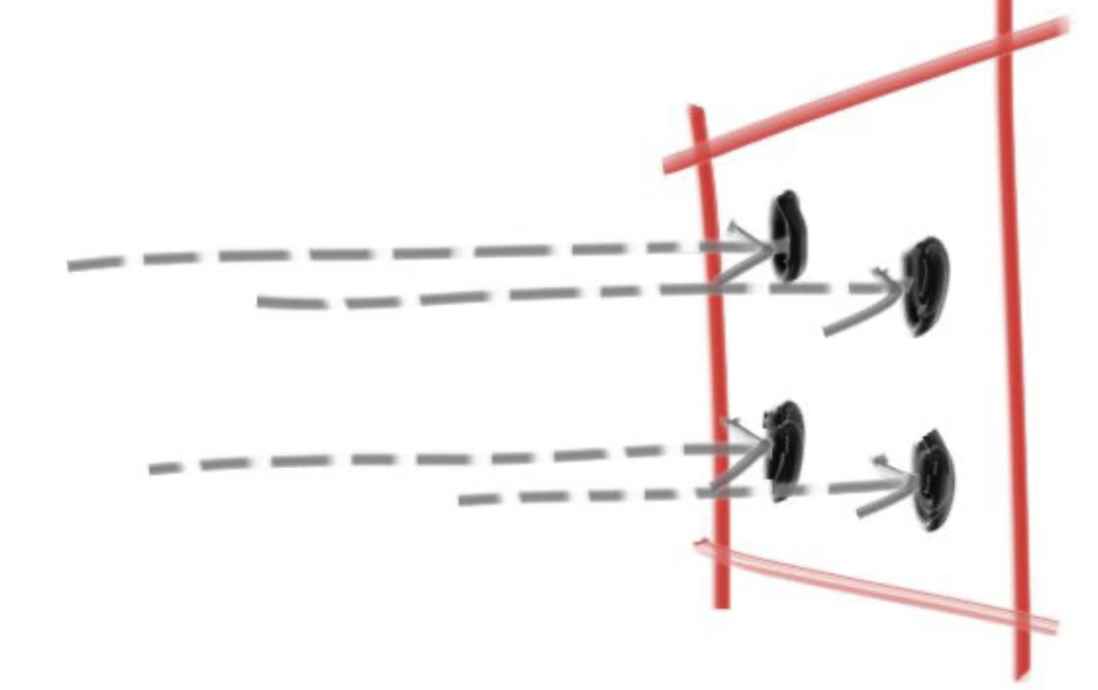
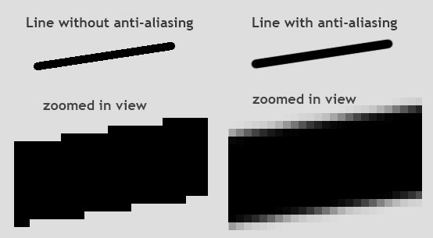
Anti-aliasing
Need Several Rays to pass through a pixel to generated a better quality image

Slide 9
Existing Optimization Techniques
In Computer Graphics, it’s generally been observed that whichever technique is more favoured or researched is generally the one which is better optimized by hardware or software to execute faster.
Since there are several ray/path tracing algorithms each designed for a different purpose: Gaming, Movie Animations, Real-Time Rendering. Optimizing by software: Developing a better algorithm that performs minimal calculations for our specific use-case. Eg: Bounding Volume Hierarchies (BVH).
Focus of Our Project : Optimizing by hardware: Given a Rendering System, configure the parallelization program to achieve Maximum Speedup in Rendering Different Scenes (At different Resolutions) with maximum utilization of the underlying hardware.
Notes:
Talk about different algorithm for different use cases, but most still try and optimized based on devices running them

Slide 10
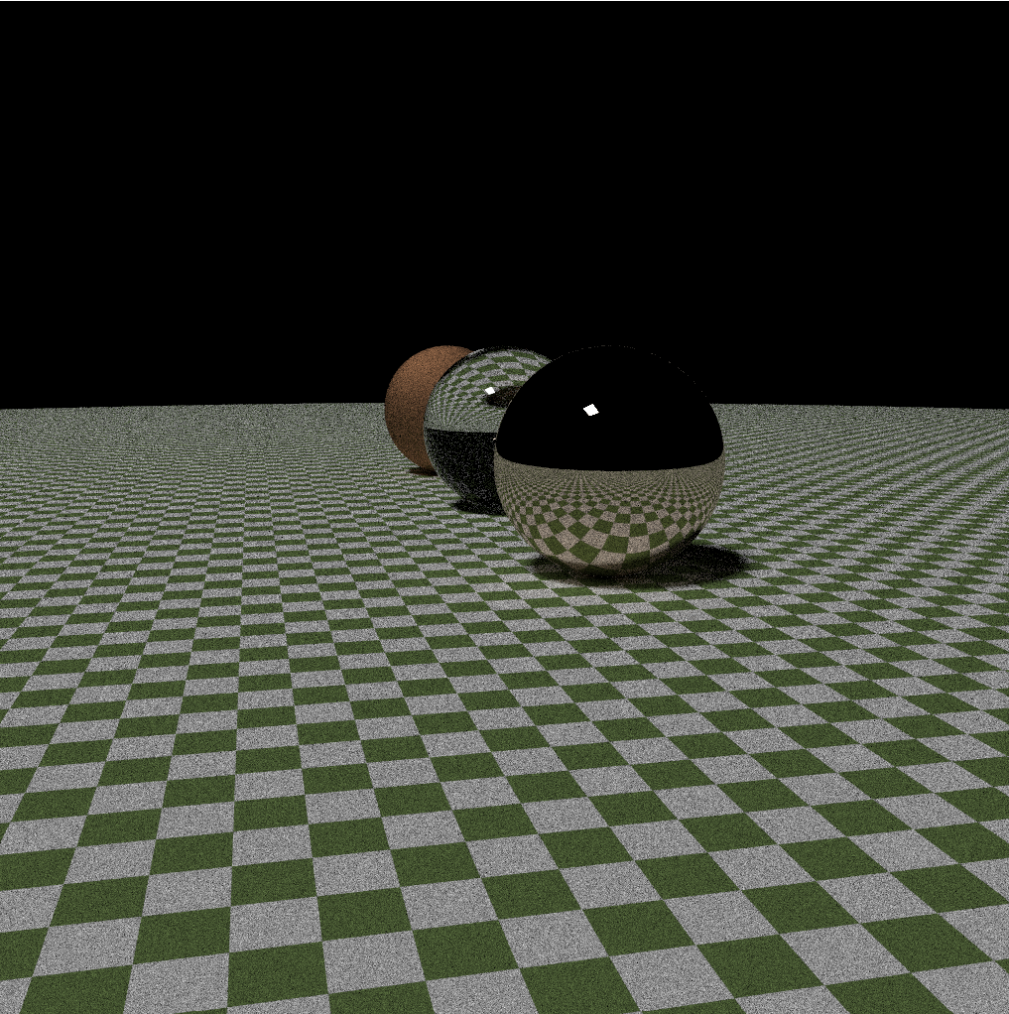
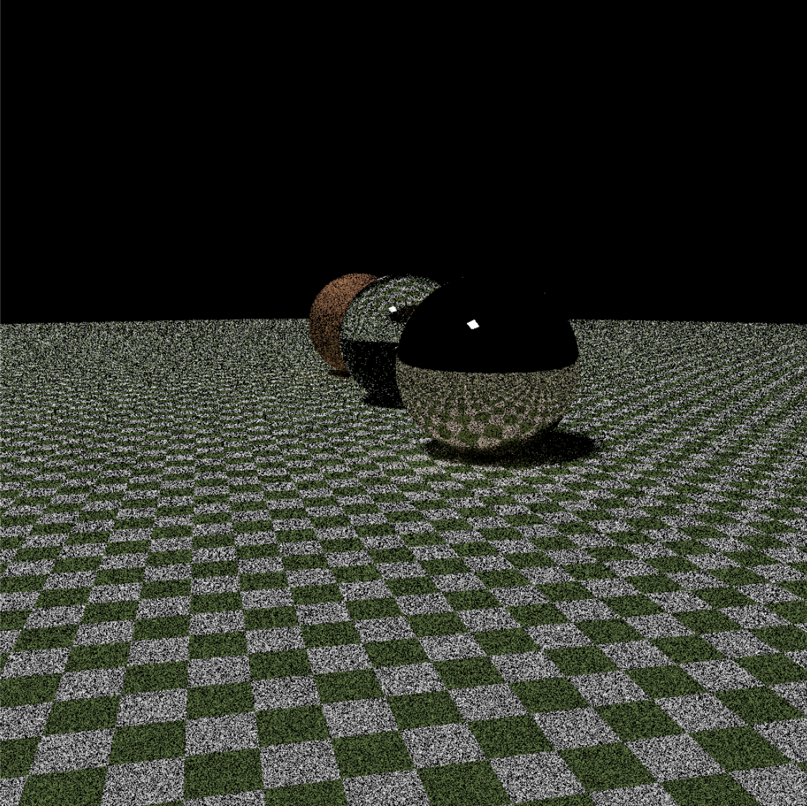
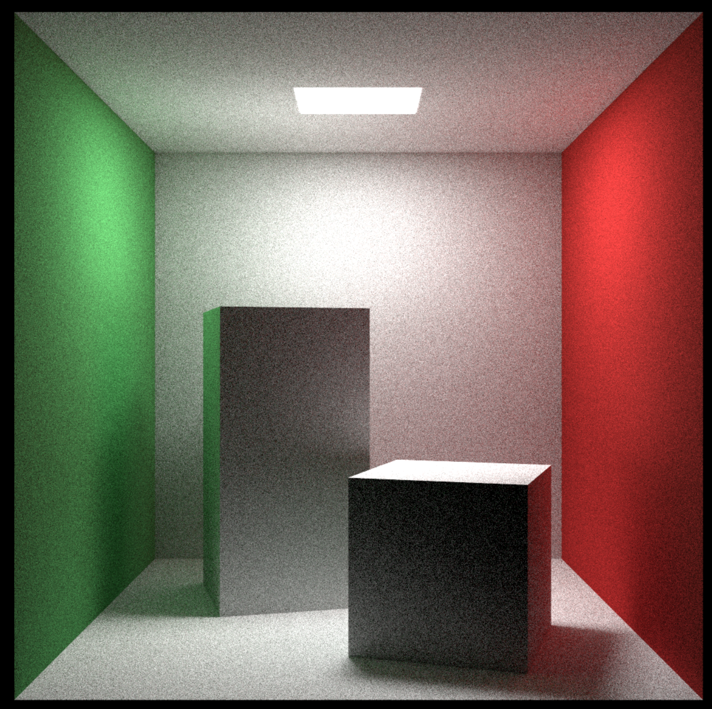
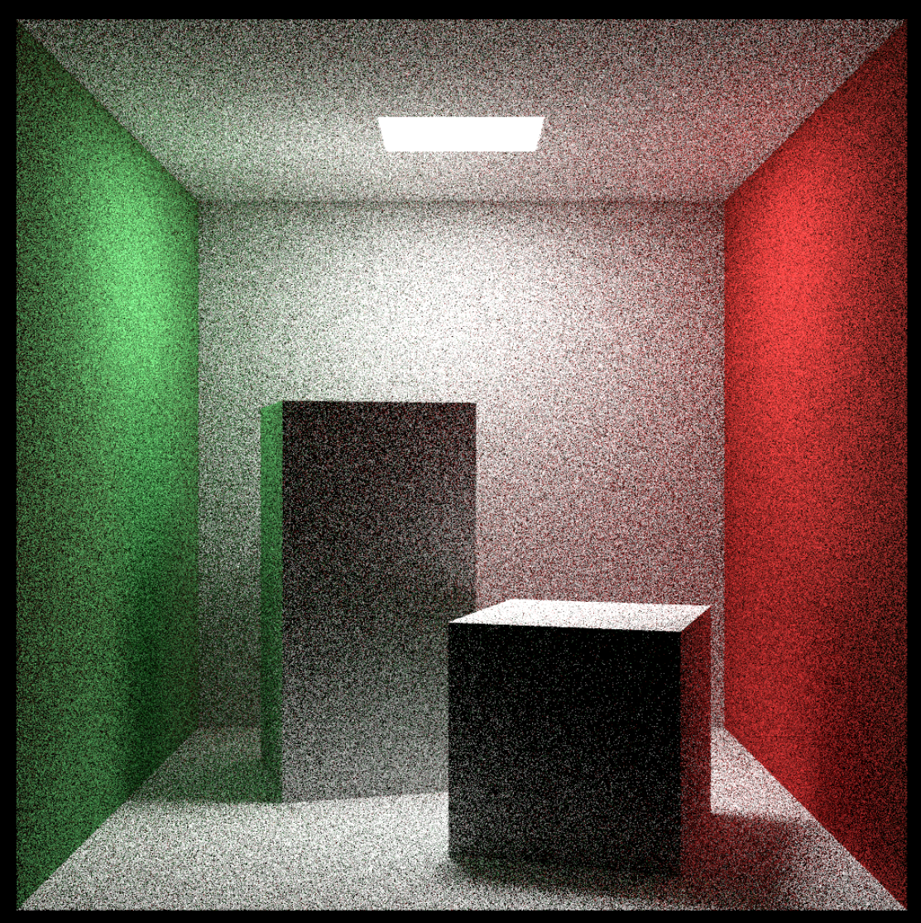
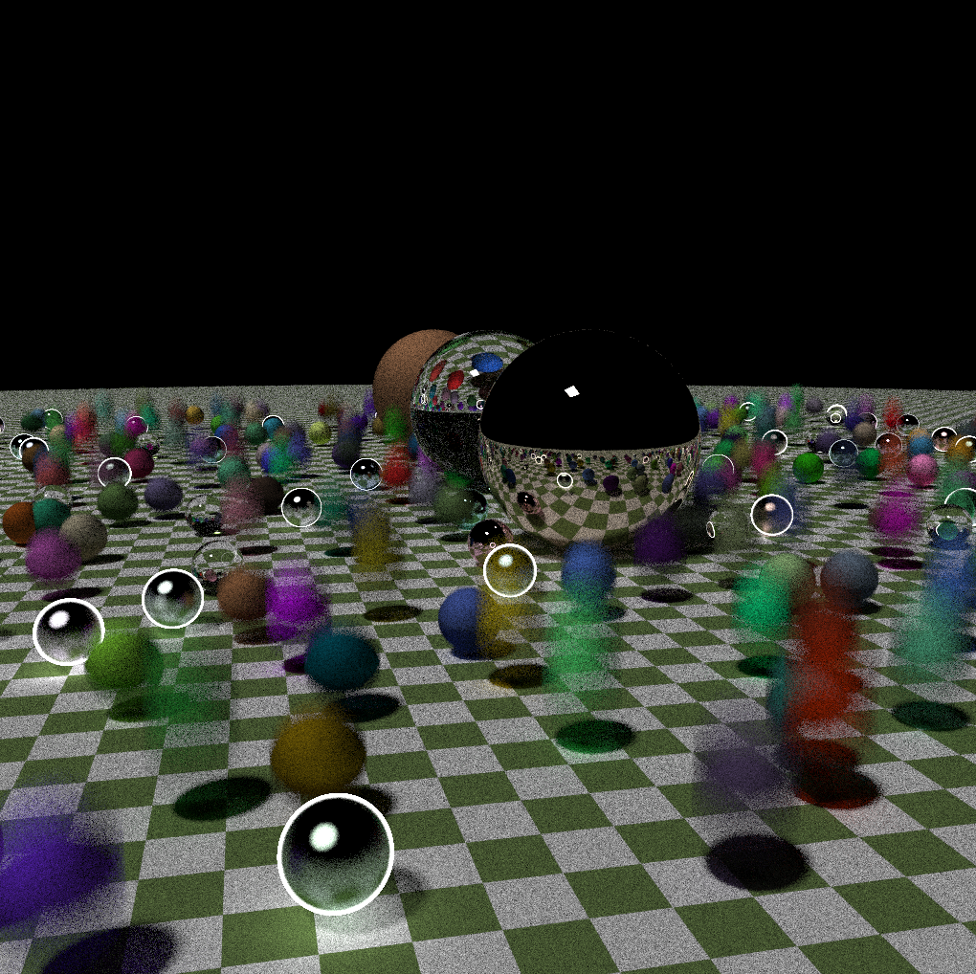
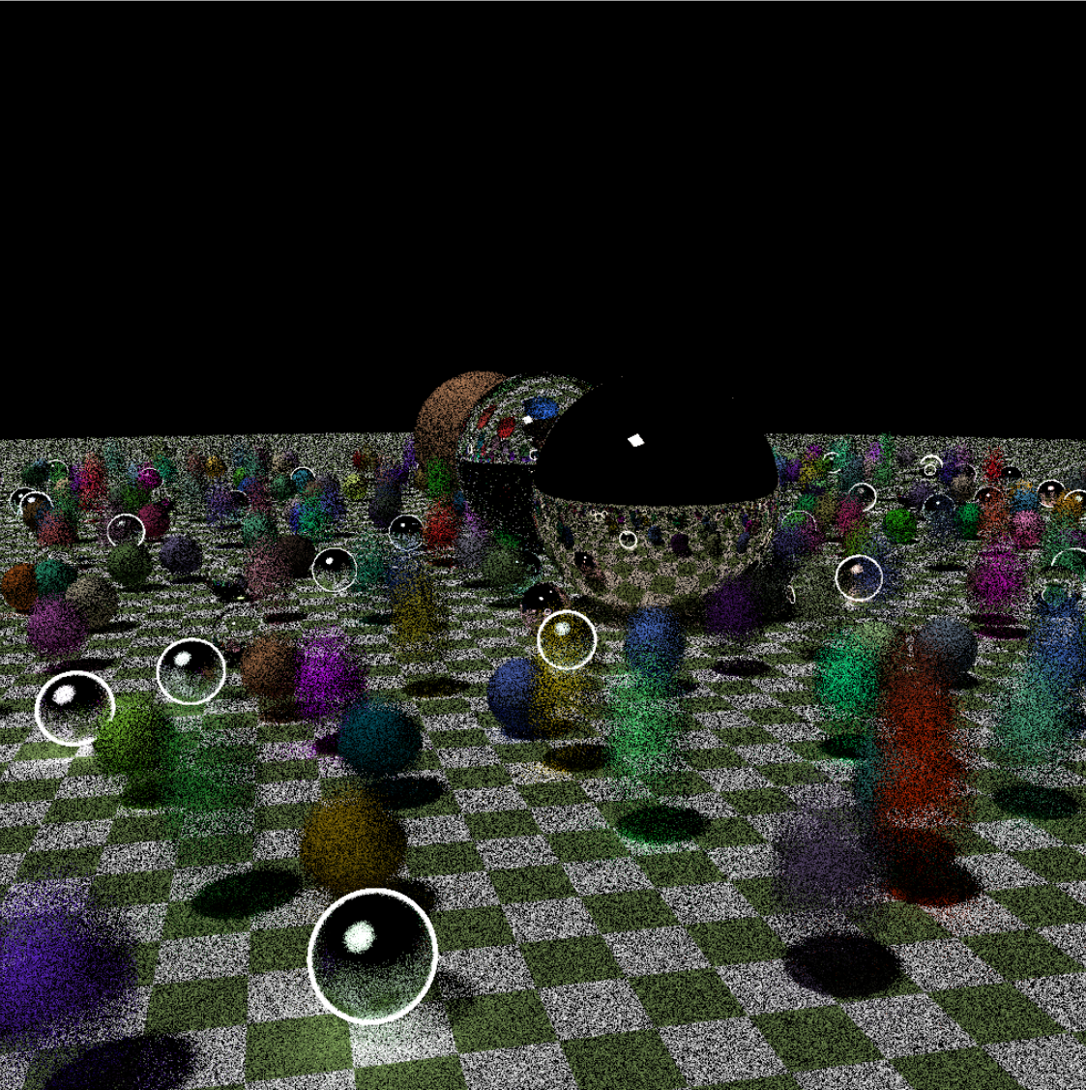
Different Scenes
Scene 2 (Unequal Workload)
Scene 1 (Equal Workload)
Scene 3 (Extreme Unequal Workload)
High Sampling Low Sampling
Notes:
Different load for different scenes, different requirements prefer different sampling rates

Slide 11
Challenges
High Memory Access
Wrap Divergence Possibility
High Resource Utilization (Example: Registers)
Block Size Selection
Load Balancing (Scene Complexity)
Regarding Parallelization
(in CUDA)
Notes:
Talk about parallelization efforts

Slide 12
Objectives
Analyze Resource Utilization while parallelizing a Rendering System using CUDA
Develop an understanding of how to fine-tune Parameters to Achieve High SpeedUp, regardless of the scene being rendered.
Modify the base software of our rendering system to better utilize the underlying hardware
Of our Project
Notes:
Talk about parallelization efforts

Slide 13
Hypothesis

Slide 14
Hypothesis
Using a Block with several threads will lead to high resource utilization and will affect occupancy per Streaming Multiprocessor
Using only a few threads per Block will lead to most of the time being consumed by block/wrap management and overhead.
There should be a range of threads per block which would result in optimal utilization of hardware(GPU) resources resulting in maximum SpeedUp.
This might vary for images of different resolutions.
The Base Rendering Software can be modified to improve the performance.
We will utilize Data Parallelism techniques as the same task is being performed at different positions in the 3D Space.

Slide 15
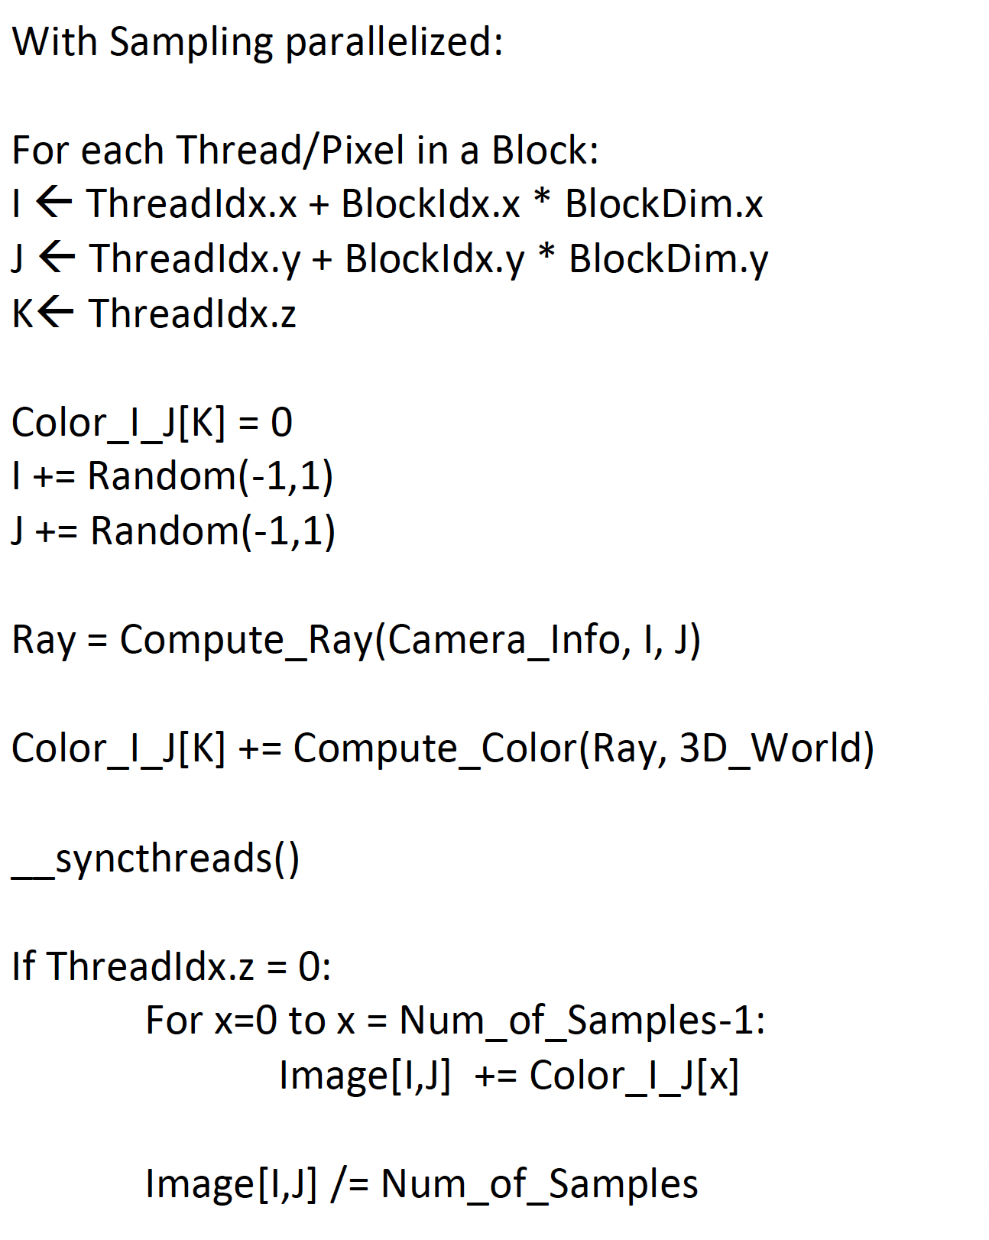
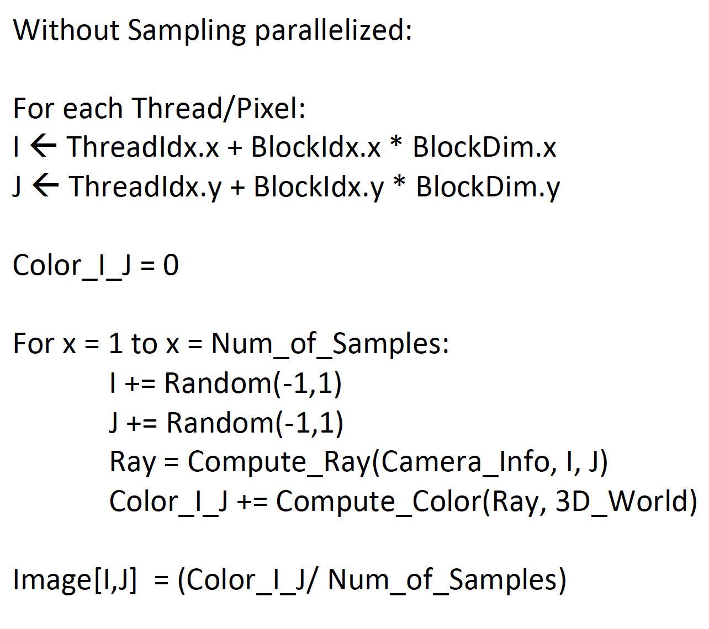
Algorithm:

Slide 16
Important Parameters
Image Resolution
Number of Samples (Sampling Rate)
Block Size (No. of Threads)
Number of objects in our 3D world
Notes:
Talk about parallelization efforts

Slide 17
Experimental Setup
Platform Used:
Hardware Specification:
System Type: 64-bit operating system, x64-based processor
Installed RAM: 16.0 GB
Processor: AMD Ryzen 9 5900HX with Radeon Graphics 3.30 GHz
GPU: Nvidia GeForce RTX 3070 Laptop version
5120 cores at 1.29 GHz,
48 wraps per SM, 64 SM total
8GB GDDR6 graphics memory w/ 256 bit memory bus at 14 GHz
Software Specification:
OS Name: Windows 11
Programming language: C++, CUDA
Programming IDE: Microsoft Visual Studio v1.66.0
Profiling Tool: Nvidia Nsight Compute v2022.1.1

Slide 18
Experimental Setup
Current Parameter Range:
Image Resolution: 256x256, 512X512, 1024x1024
Number of Samples: 8, 1024
Block Size: 8x8, 16x16, 32x32, 64x8, 128x1, 256x1
Number of Objects in 3D world: 4, 7, 404

Slide 19
Results & Analysis

Slide 20
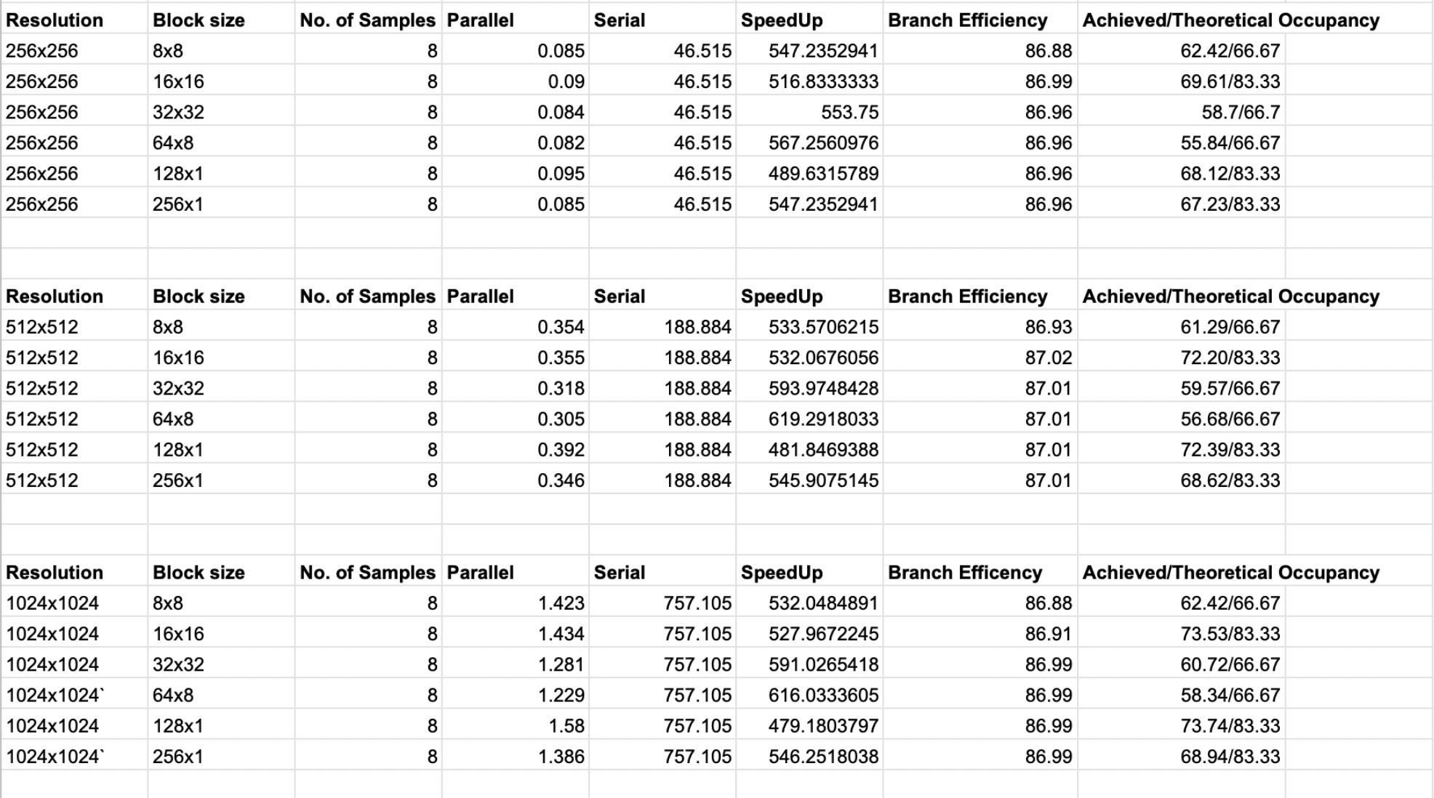
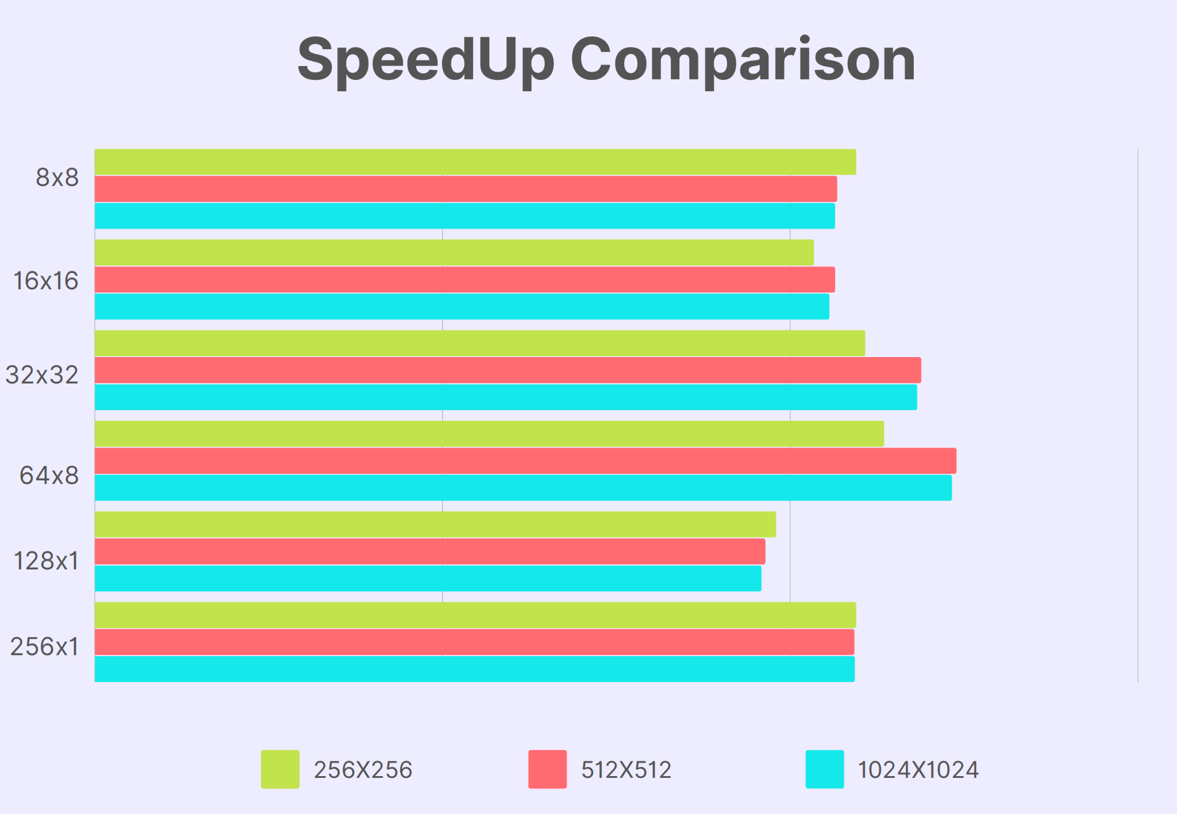
Scene 1(Equal WorkLoad)

Slide 21
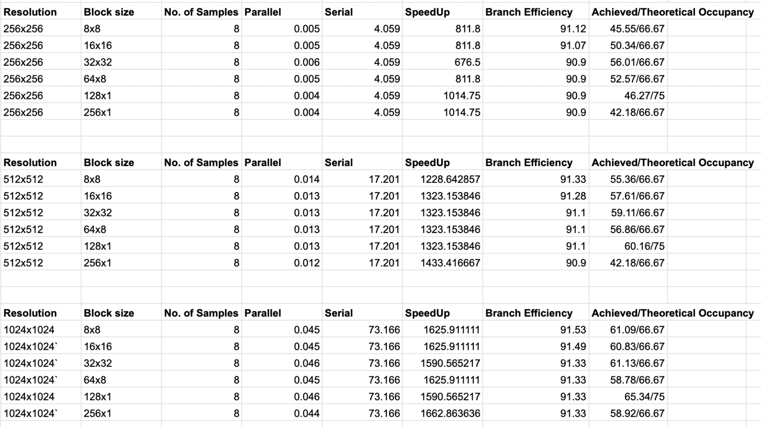
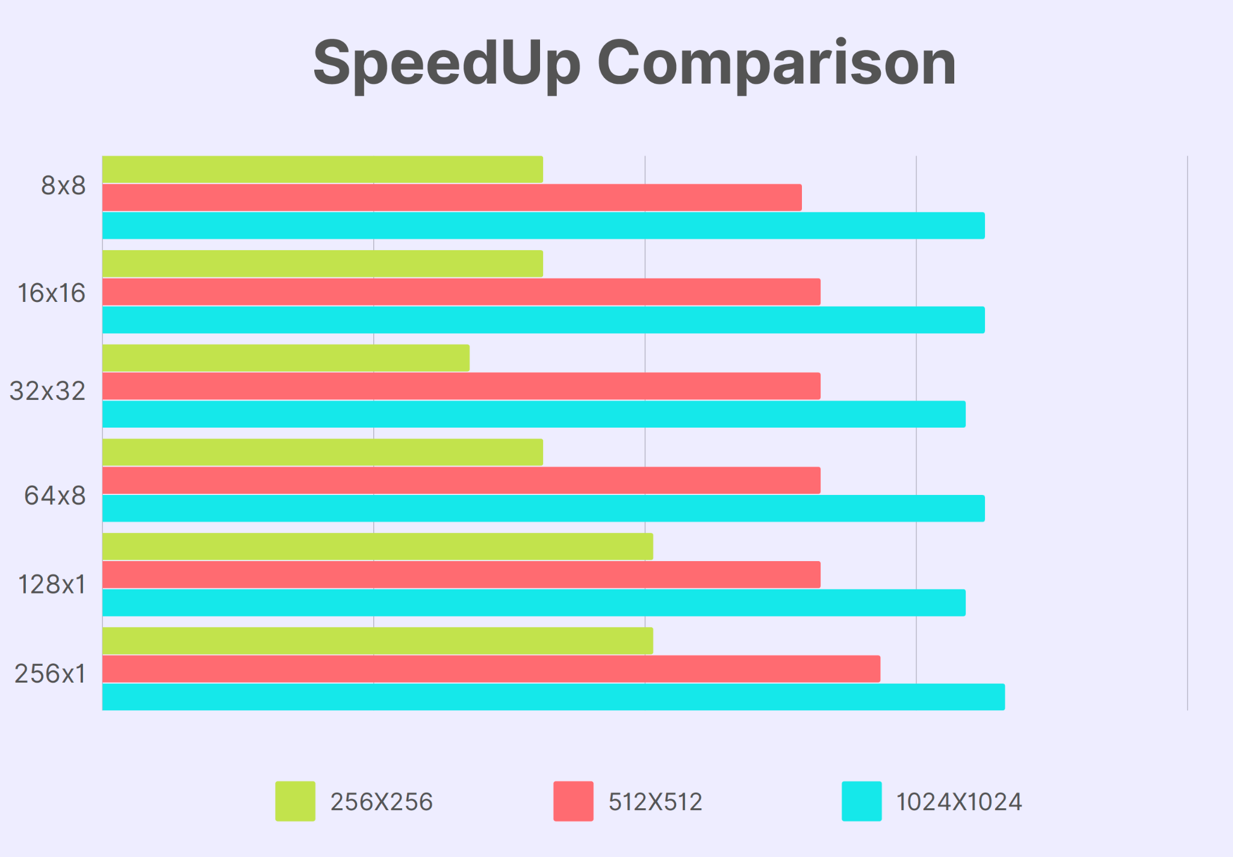
Scene 2 (Unequal WorkLoad)

Slide 22
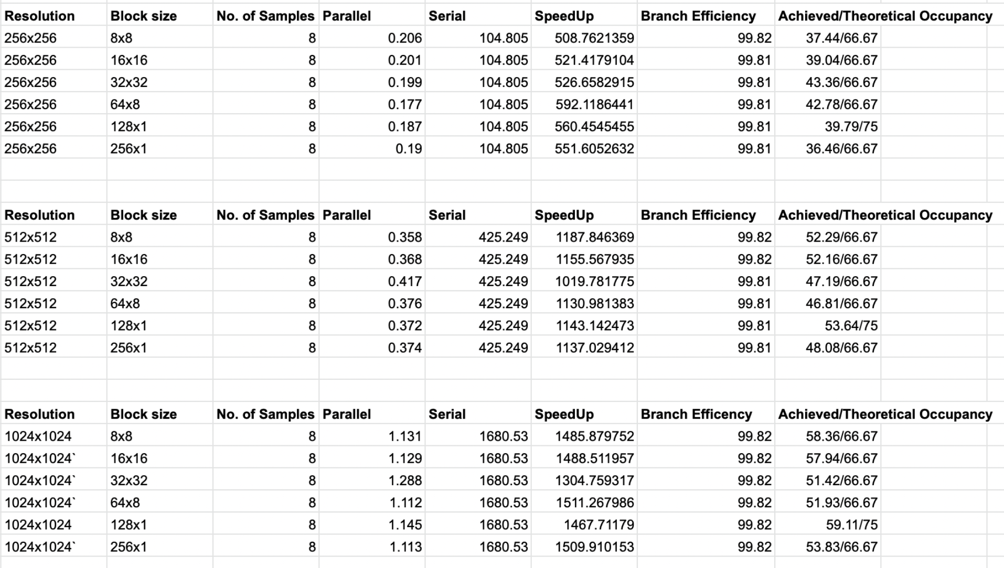
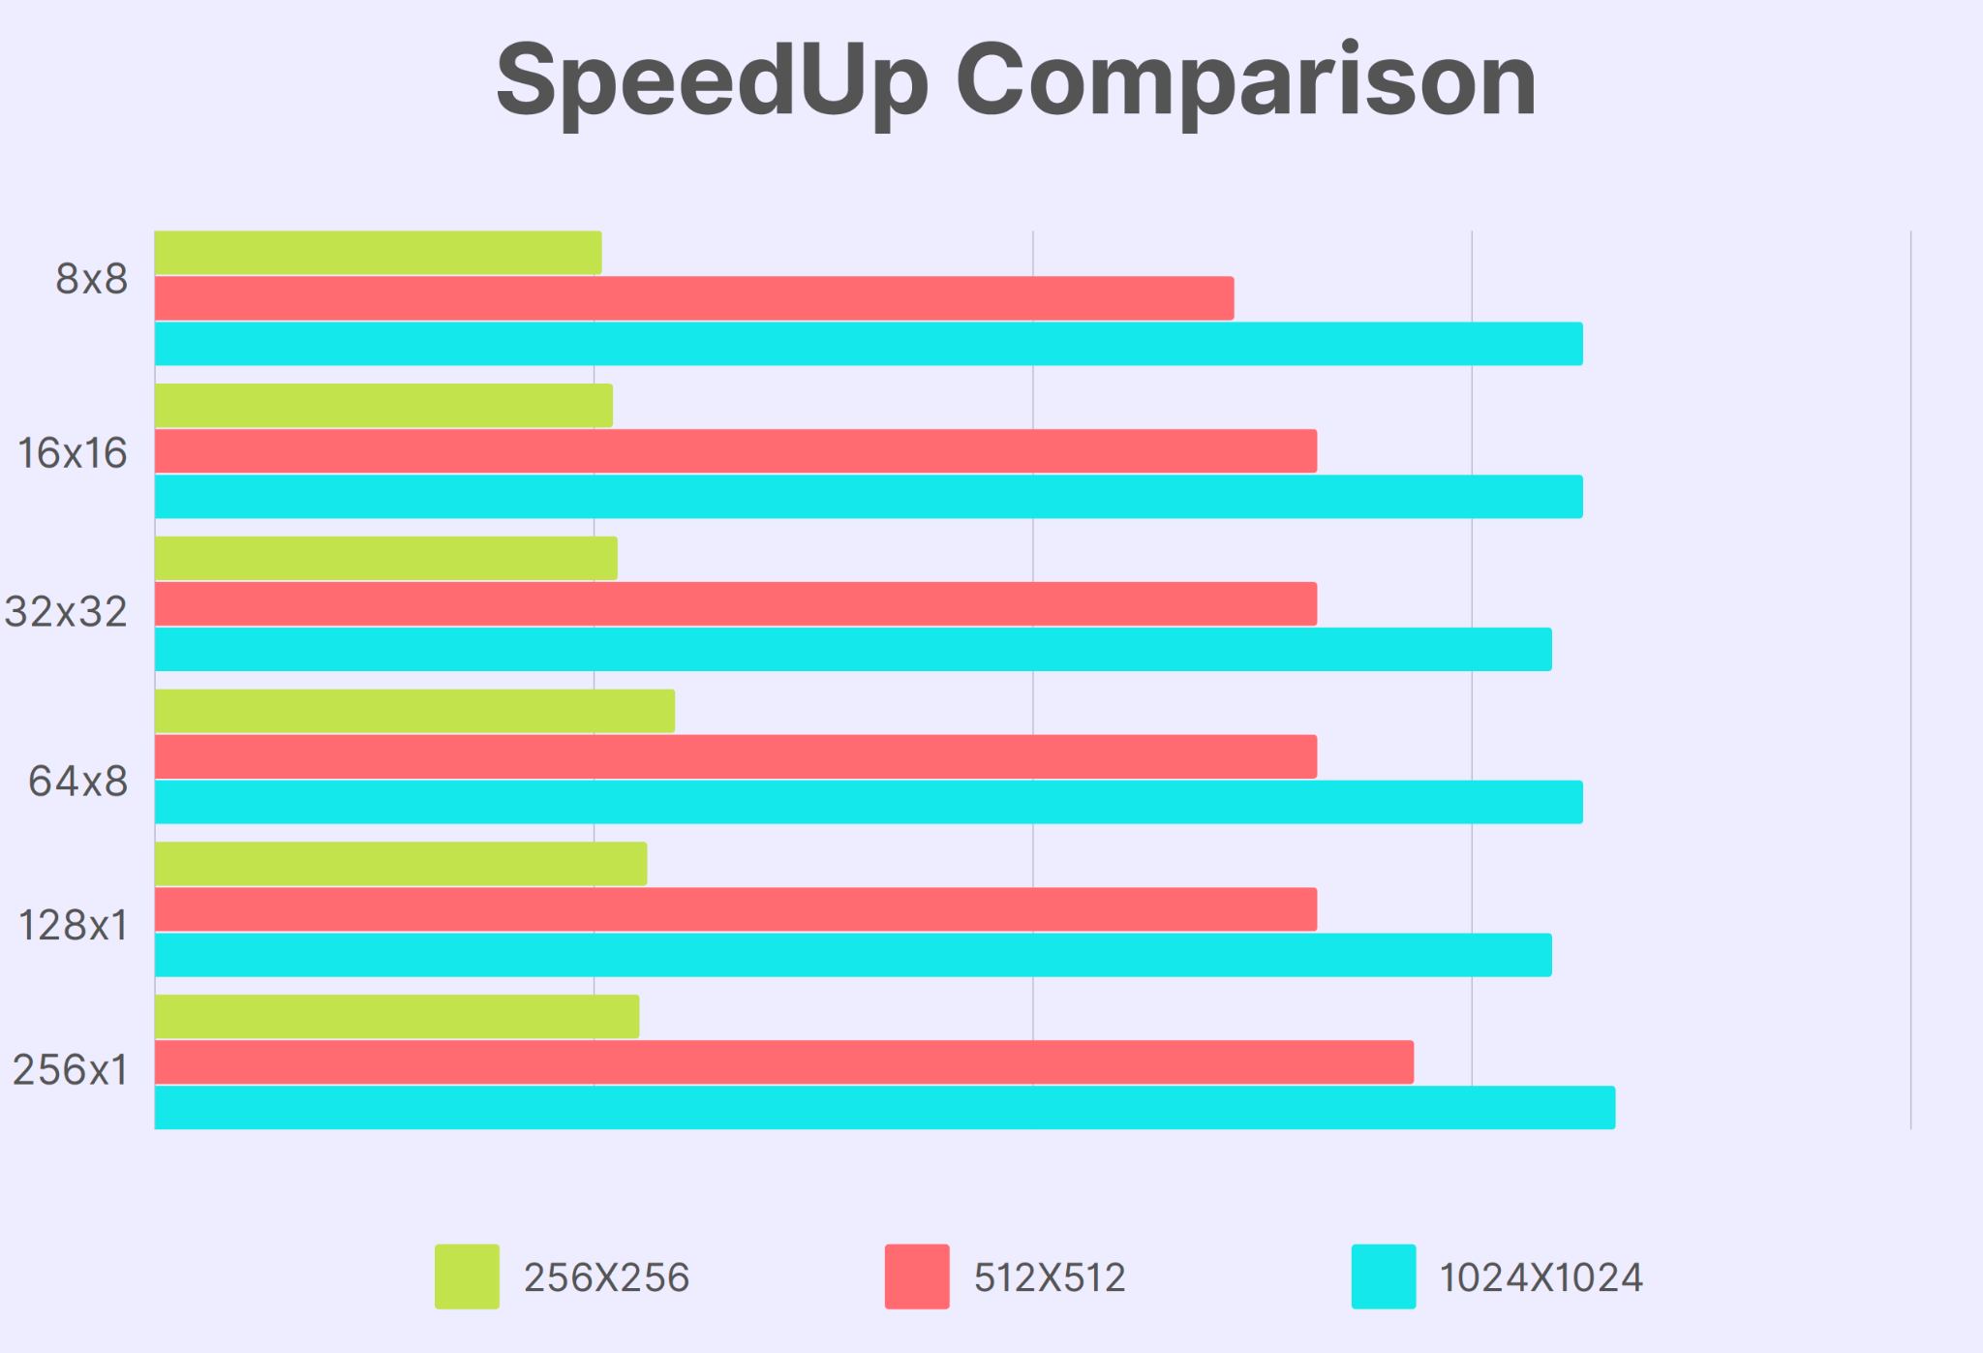
Scene 3 (Extreme Unequal WorkLoad)

Slide 23
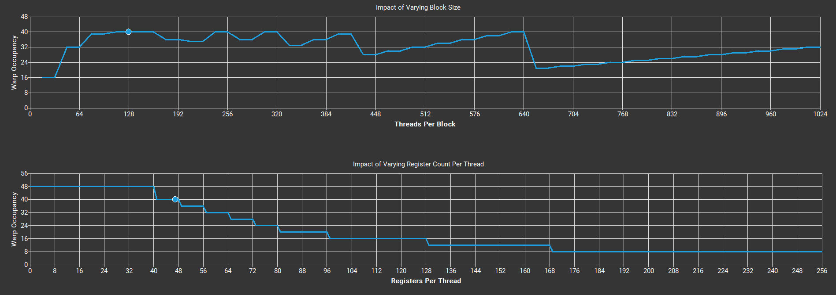
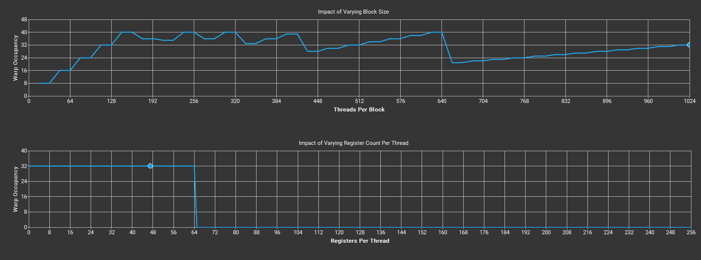
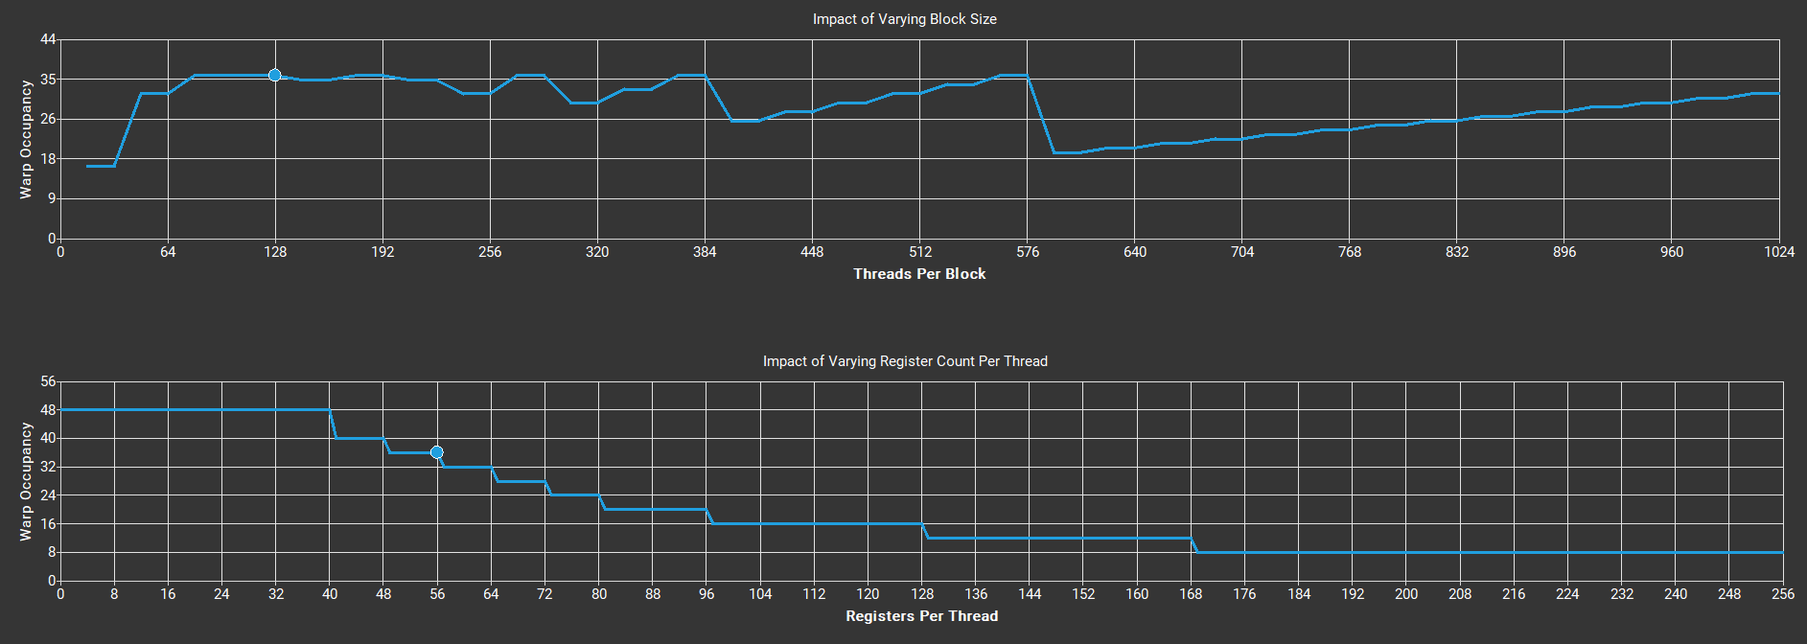
Occupancy Chart
SCENE1 256x256_8_32x32
(40/48 = 0.834)
SCENE2 256x256_8_128x1
(36/48 = 0.75)
SCENE3 256x256_8_32x32 (32/48 = 0.667)

Slide 24
Further Work
Analyze Rendering system performance with sampling parallelized
Optimize Path Tracing for images with high sampling
Deduce best range for parameters to achieve high speedup
Notes:
Talk about parallelization efforts

Slide 25
References
Whitted, Turner. "An improved illumination model for shaded display." Proceedings of the 6th annual conference on Computer graphics and interactive techniques. 1979.
James T. Kajiya. 1986. The rendering equation. SIGGRAPH Comput. Graph. 20, 4 (Aug. 1986), 143–150. DOI:https://doi.org/10.1145/15886.15902
Peter Shirley’s, “Ray tracing in One Weekend Series”
https://docs.nvidia.com/cuda/
https://docs.nvidia.com/nsight-compute/2022.1/index.html
Notes:
Talk about parallelization efforts

